Slide 1


Electric Circuits
Twelfth Edition, Global Edition
Chapter 5 – Part 1
The Operational Amplifier
© 2024 Pearson Education Ltd. All Rights Reserved.
Notes:
If this PowerPoint presentation contains mathematical equations, you may need to check that your computer has the following installed:
1) Math Type Plugin
2) Math Player (free versions available)
3) NVDA Reader (free versions available)

Slide 2
Objectives
5.1 Be able to identify and name the terminals of an op amp
5.2 Be able to state the constraints that characterize an ideal op amp
5.3 Know how to recognize and analyze the following op amp circuits: inverting amplifier, summing amplifier, non-inverting amplifier, difference amplifier

Slide 3
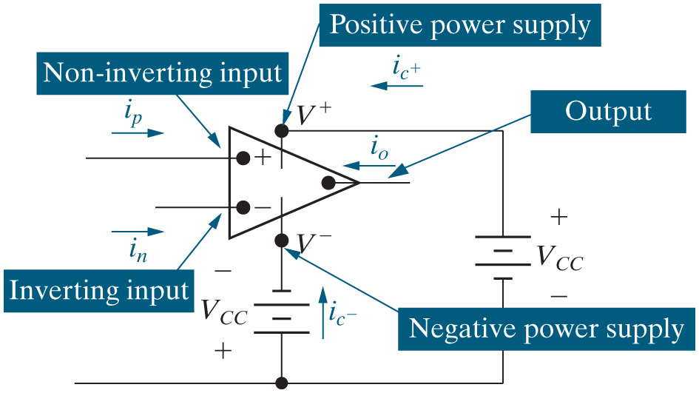
Chapter 5 – Op Amps (1 of 22)
Terminal names, voltages and currents

Slide 4
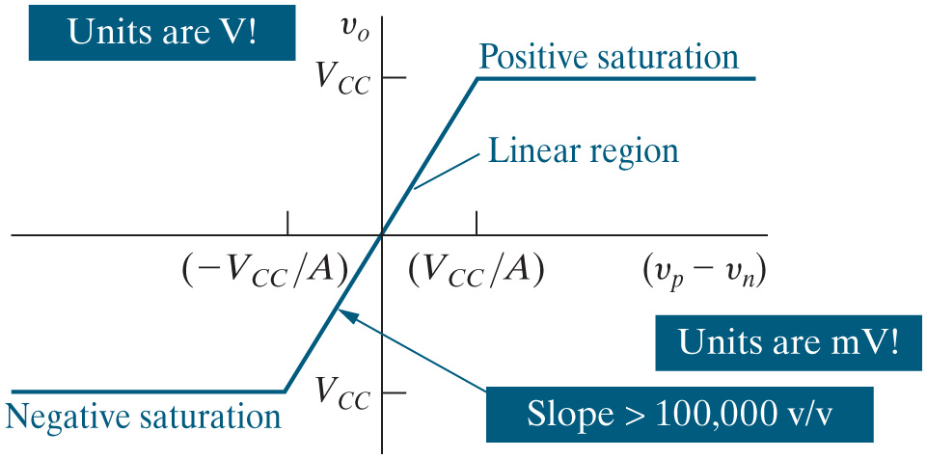
Chapter 5 – Op Amps (2 of 22)
Voltage transfer characteristic

Slide 5


Chapter 5 – Op Amps (3 of 22)
Op amps are inherently linear devices.
A. True
B. False

Slide 6
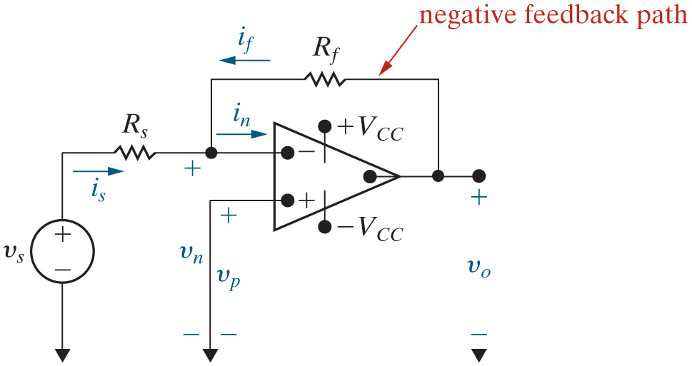
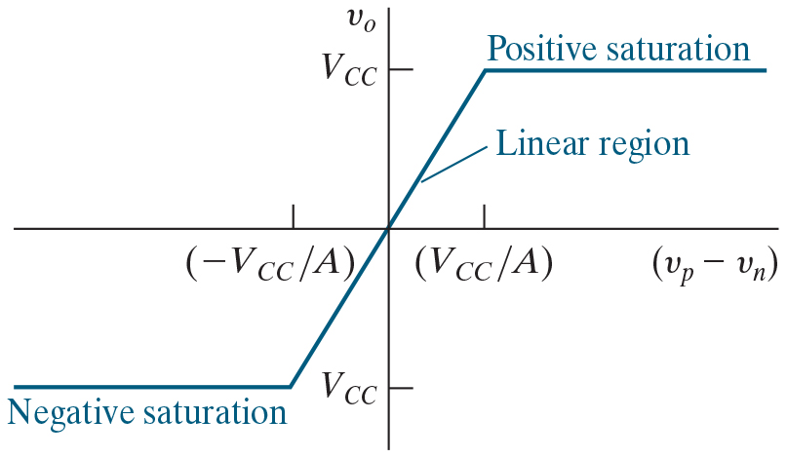
Chapter 5 – Op Amps (4 of 22)
Since this class only deals with linear circuits, we use op amps only when they are operating in their linear region.
How can we configure an op amp to operate in its linear region? Negative feedback!

Slide 7
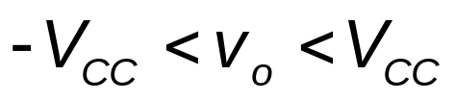
Chapter 5 – Op Amps (5 of 22)
How can we be sure that the op amp is operating in its linear region? We can’t! We must assume that it is operating in its linear region, complete our circuit analysis, and check our assumption. If the op amp is operating in its linear region,

Slide 8

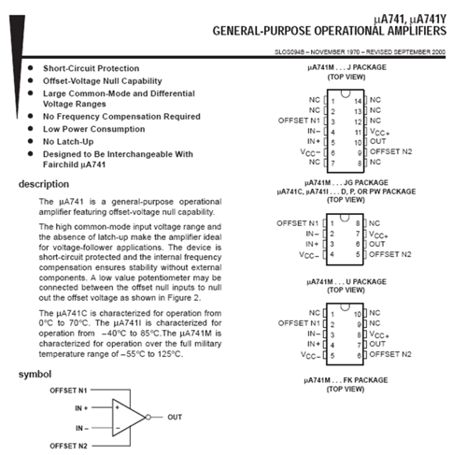
Chapter 5 – Op Amps (6 of 22)
Texas Instruments
op amp data sheet

Slide 9
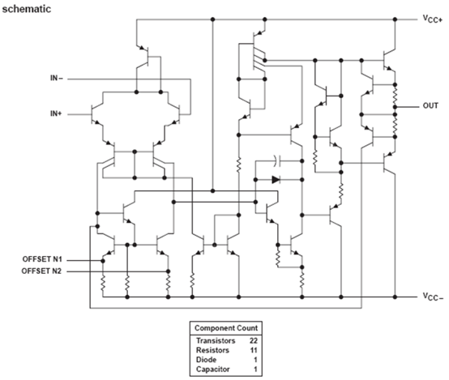
Chapter 5 – Op Amps (7 of 22)
T I
op amp data sheet (continued)

Slide 10
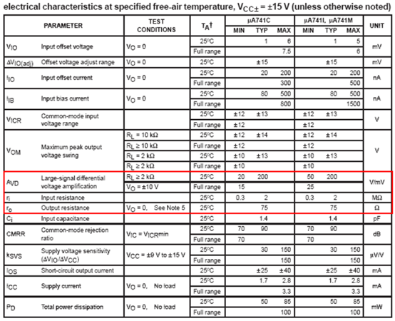
Chapter 5 – Op Amps (8 of 22)
T I
op amp data sheet (continued)

Slide 11



Chapter 5 – Op Amps (9 of 22)
In a uA741 op amp, the voltage gain in the linear operating region is 200,000 V/V. In an ideal op amp, the voltage gain in the linear region is
A. About the same
B. Much smaller
C. 0
D.

Slide 12

Chapter 5 – Op Amps (10 of 22)
In a uA741 op amp, the input resistance is about
In an ideal op amp, the input resistance is
A. About the same
B. Much smaller
C. 0
D.

Slide 13

Chapter 5 – Op Amps (11 of 22)
In a uA741 op amp, the output resistance is about
In an ideal op amp, the output resistance is
A. About the same
B. Much larger
C. 0
D.

Slide 14
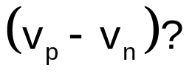
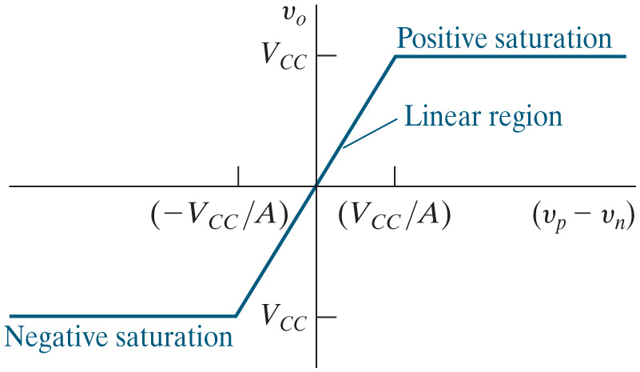

Chapter 5 – Op Amps (12 of 22)
In an ideal op amp, the voltage gain in the linear region is
infinite. Therefore, what is
A. 0
B. 200,000
C.
D.

Slide 15
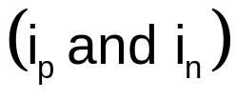
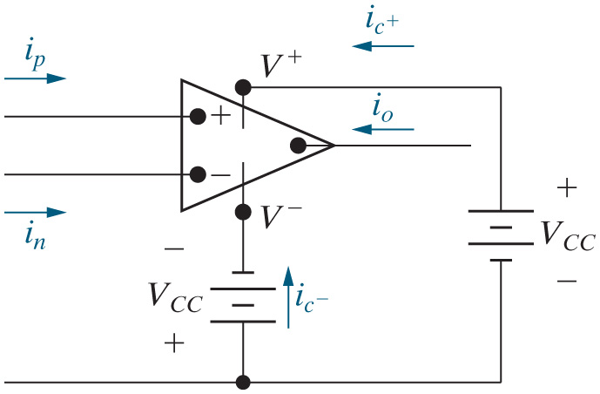
Chapter 5 – Op Amps (13 of 22)
In an ideal op amp, the input resistance is infinite. Therefore,
the currents flowing into the input of the op amp
are
A. Both infinite
B. Both zero
C. Determined by circuit analysis
D. Undefined

Slide 16
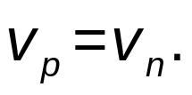

Chapter 5 – Op Amps (14 of 22)
We usually assume the op amp is ideal and operating in its linear region. This allows us to make two important assumptions that simplify the circuit analysis:
The voltages at the inverting and non-inverting input terminals are the same with respect to a common
reference node. That is,
The currents entering the inverting and non-inverting input
terminals are both zero. That is,

Slide 17
Chapter 5 – Op Amps (15 of 22)
The analysis method for circuits with ideal op amps:
Step 1 – Check for a negative feedback path. If it exists, assume the op amp operates in its linear region.
Step 2 – Write a K C L equation at the inverting input terminal.
Step 3 – Solve the K C L equation and use the solution to find the op amp’s output voltage.
Step 4 – Compare the op amp’s output voltage to the power supply voltages to determine if the op amp is operating in its linear region or if it is saturated.

Slide 18


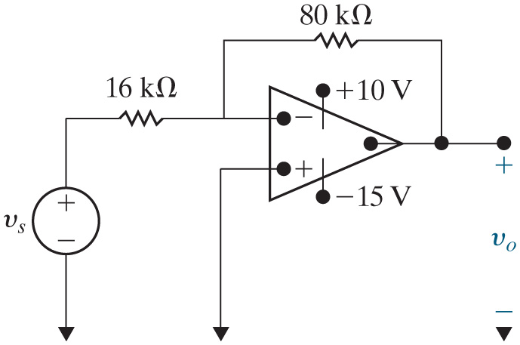



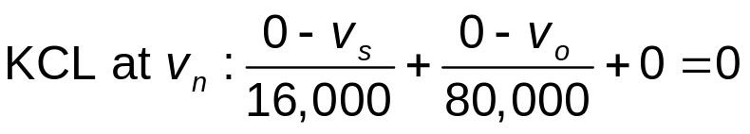
Chapter 5 – Op Amps (16 of 22)
Example
Find
for
and
Assume the op amp is ideal.
Step 1 – Check for a negative feedback path. It exists, so assume the op amp operates in its linear region.
Step 2 – Write a K C L equation at the inverting input terminal. Use
the op amp assumptions that
and

Slide 19
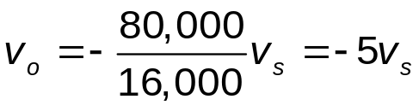
Chapter 5 – Op Amps (17 of 22)
Example
Find
for
and
Assume the op amp is ideal.
Step 3 – Solve the K C L equation and use the solution to find the op amp’s output voltage.

Slide 20










Chapter 5 – Op Amps (18 of 22)
Example
Find
for
and
Assume the op amp is ideal.
Step 4 – Compare the op amp’s output voltage with the power supply voltages to determine if the op amp is operating in its linear region or if it is saturated. The results are shown in the table.
v subscript s Open Square Bracket V Close Square Bracket | V subscript O equals negative 5 v subscript s open square bracket V close square bracket | OK?
0 point 4 | Negative 2 point 0 | Yes
2 point 0 | Negative 10 point 0 | Yes
3.5 | Negative 17 point 5 | NO – saturate at −15 V
Negative 0 point 6 | 3 point 0 | Yes
Negative 1 point 6 | 8 point 0 | Yes
−2.4 | 12 point 0 | NO – saturate at 10 V

Slide 21


Chapter 5 – Op Amps (19 of 22)
Example, continued
Find the range of input voltages
for which the op amp
operates in its linear region.

Slide 22

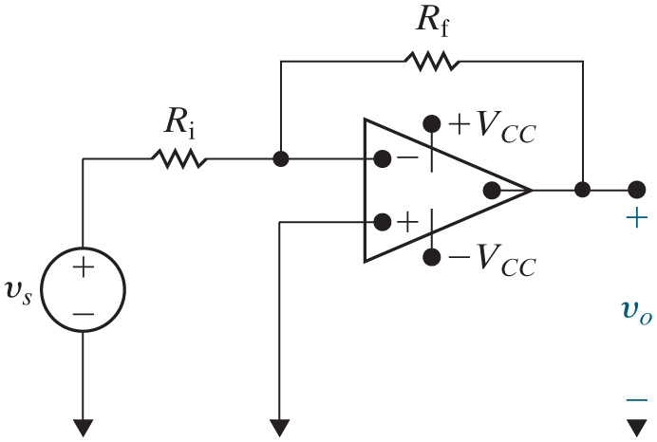
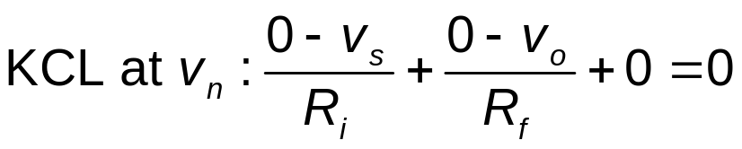
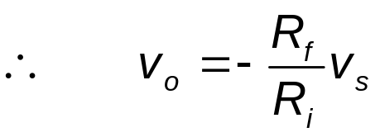
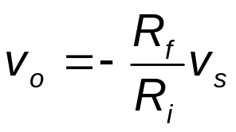

Chapter 5 – Op Amps (20 of 22)
Inverting Amplifier
Design equation:
only if

Slide 23
Chapter 5 – Op Amps (21 of 22)
In describing op amp circuits, the term “inverting” means
A. Changing the sign
B. Operating linearly
C. 1/(the input)
D. All of the above

Slide 24

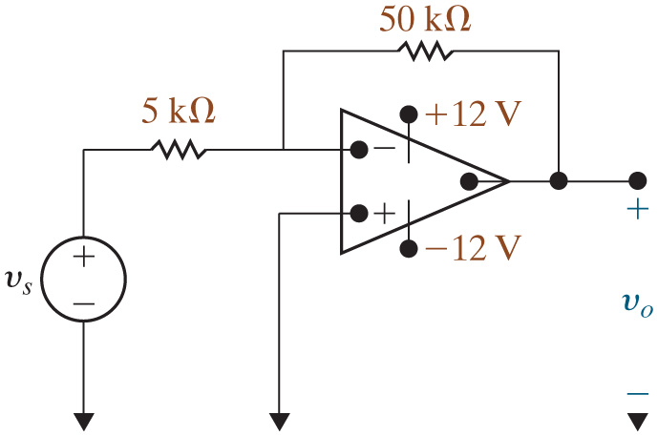


Chapter 5 – Op Amps (22 of 22)
Design an inverting amplifier with a gain of 10. Use
power
Choose a feedback resistor and input resistor such that their ratio is 10 – one possibility is shown below:
for

Slide 25

Copyright
This work is protected by United Kingdom copyright laws and is provided solely for the use of instructors in teaching their courses and assessing student learning. Dissemination or sale of any part of this work (including on the World Wide Web) will destroy the integrity of the work and is not permitted. The work and materials from it should never be made available to students except by instructors using the accompanying text in their classes. All recipients of this work are expected to abide by these restrictions and to honor the intended pedagogical purposes and the needs of other instructors who rely on these materials.

